Slide 1
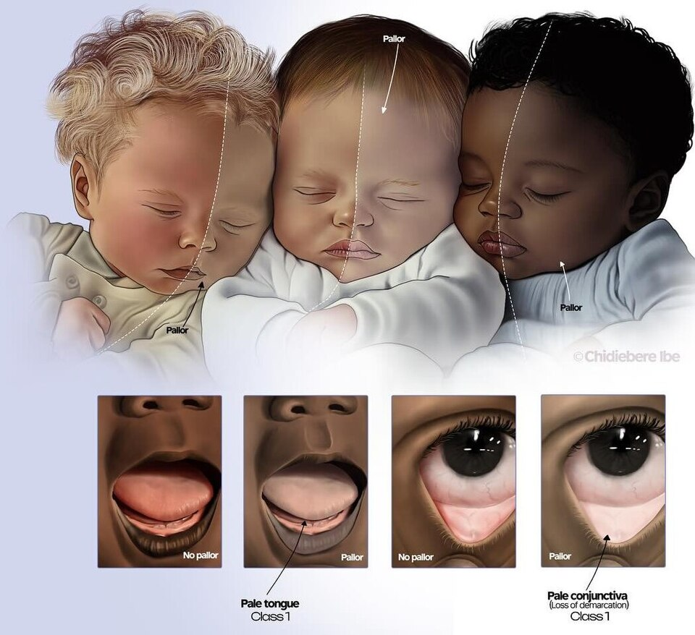

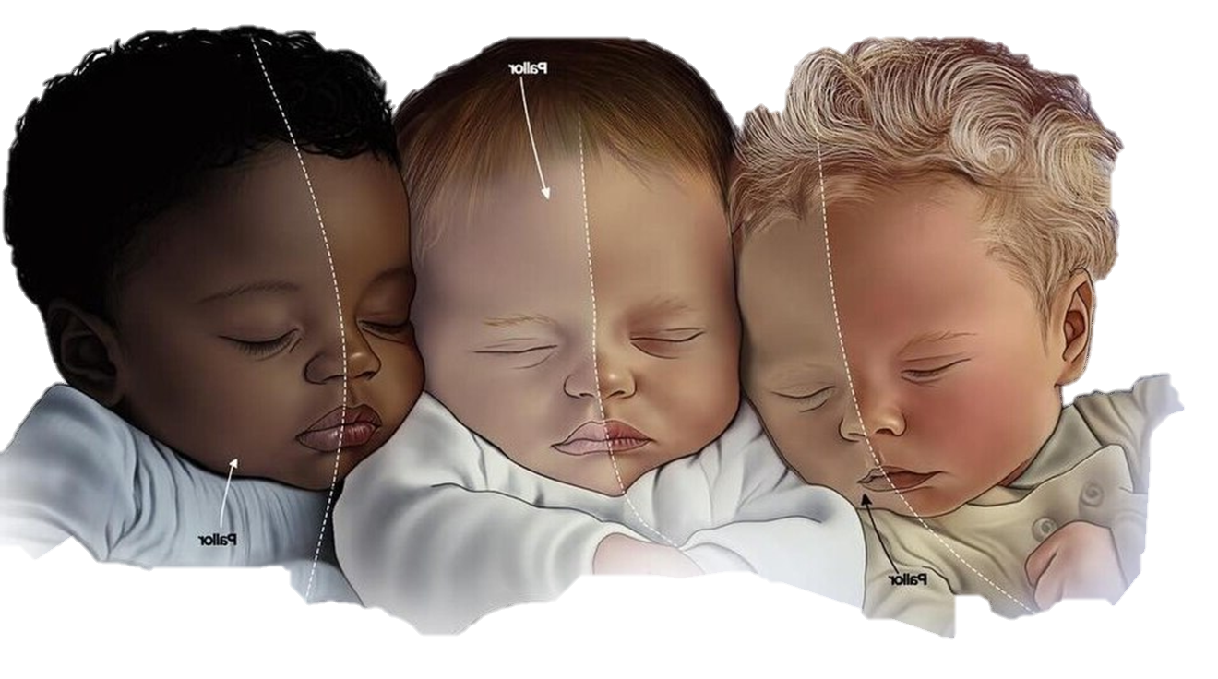
Child With Pallor
University of Ajdabiya
faculty of medicine
Department of Pediatrics
University of
Ajdabiya
Department of
Pediatrics
Seminar
Presented by
Supervised by:
Dr. Omlsaed Amamir
Dr. Om Elezz Salheen
Asma Abdelsalam
Ibrahem Salem
Fatima Saleh
Najma Juma
Rouah Salem
Fatima Hussein
Monira Ahmed
Israa Hussein
Noor Mohammed
Ritaj Sabir
Emad Ahmed
Pallor
Pallor
Pallor

Slide 2
INTRODUCTION
Pallor is a common clinical sign encountered in children and may be the first indication of an underlying systemic condition.
Although often associated with anemia, pallor can result from non-hematological causes.
Recognizing pallor requires differentiating between benign physiological variants and life-threatening hematological, malignant, or systemic disorders.
Pallor is a clinical sign rather than a diagnosis itself.

Slide 3
Definition of pallor
Pallor is an abnormal whitening or loss of the normal pink color of the skin and mucous membranes.
“
”

Slide 4
Factors affecting the pallor:
Oxyhemoglobin status
Cutaneous microvasculature
Thickness of epidermis / melanin pigment

Slide 5
Learning Objectives:
Define pallor and understand its clinical significance in children.
Differentiate between pallor associated with anemia and pallor due to non-anemic causes
Apply a systematic approach to the evaluation of a child with pallor, including history, examination, and investigations.
Discuss the basic principles of management and emergency care of children presenting with pallor.

Slide 6
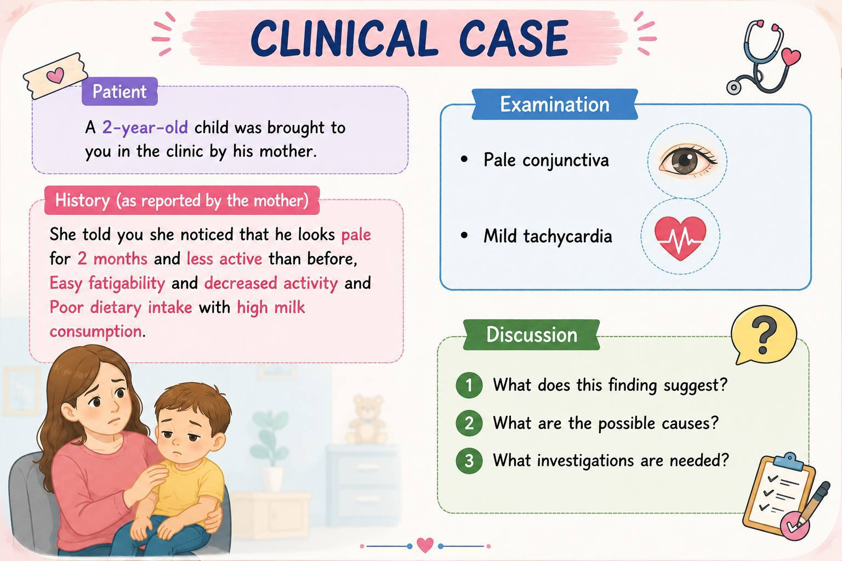

Slide 7
PART 1
Pathophysiology of Pallor and How To Confirm Pallor

Slide 8
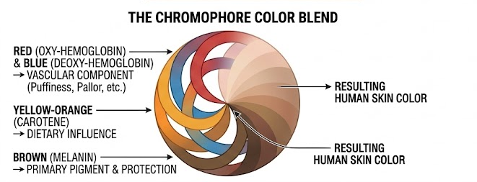
Physiology of skin color
Skin color is a blend resulting from the skin chromophores red (oxy-hemoglobin), blue (deoxy-hemoglobin), yellow-orange (carotene) and brown (melanin).
https://www.sciencedirect.com/science/article/abs/pii/S0151963812701230

Slide 9
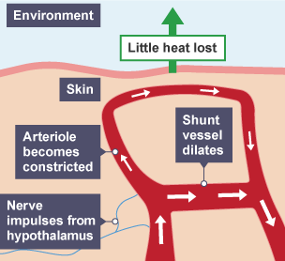
Mechanism of pallor
Pallor develops through two mechanisms:
  Decrease in hemoglobin mass (anemic pallor)
    A quantitative reduction in circulating red blood cells or hemoglobin concentration
  Cutaneous vasoconstriction (vasomotor pallor)
    Cold exposure (to decrease heat loss)
    Sympathetic activation (to increase the perfusion to the vital organs)
      - hypovolemia
      - shock
      - pain
      - anxiety
      - acute stress

Slide 10
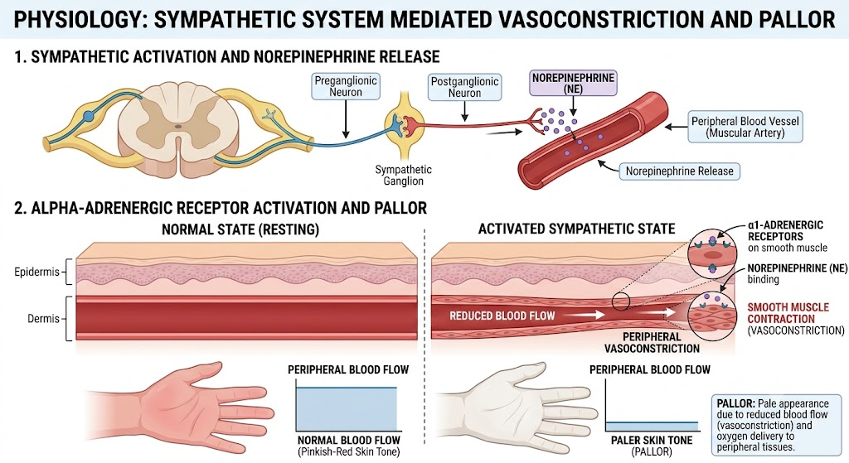
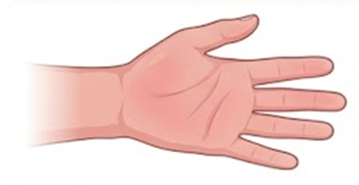
Mechanism of pallor

Slide 11
How to confirm true pallor?
To overcome assessment challenges like ambient lighting, skin thickness, and ethnic pigmentation, clinicians inspect specific anatomical sites (Areas with superficial capillaries & minimal melanin) like:
  Conjunctiva
  Tongue
  Palm
  Nailbed

Slide 12
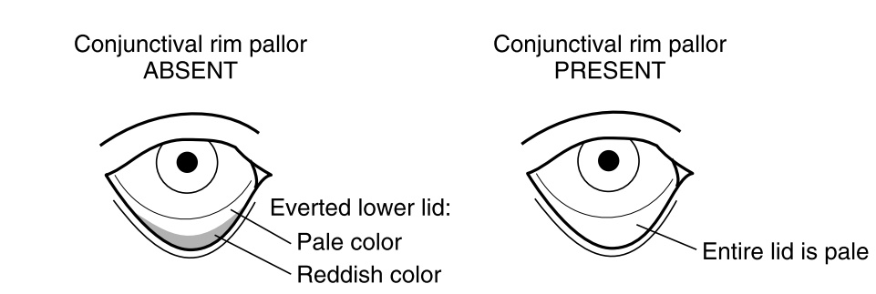
How to confirm true pallor?
CONJUNCTIVA: Classified as pale if the anterior rim of the lower palpebral conjunctiva appeared as pale as the deeper posterior rim.
Kalantri A and others. Accuracy and reliability of pallor for detecting anaemia: a hospital-based diagnostic accuracy study. PLoS One. 2010 Jan

Slide 13
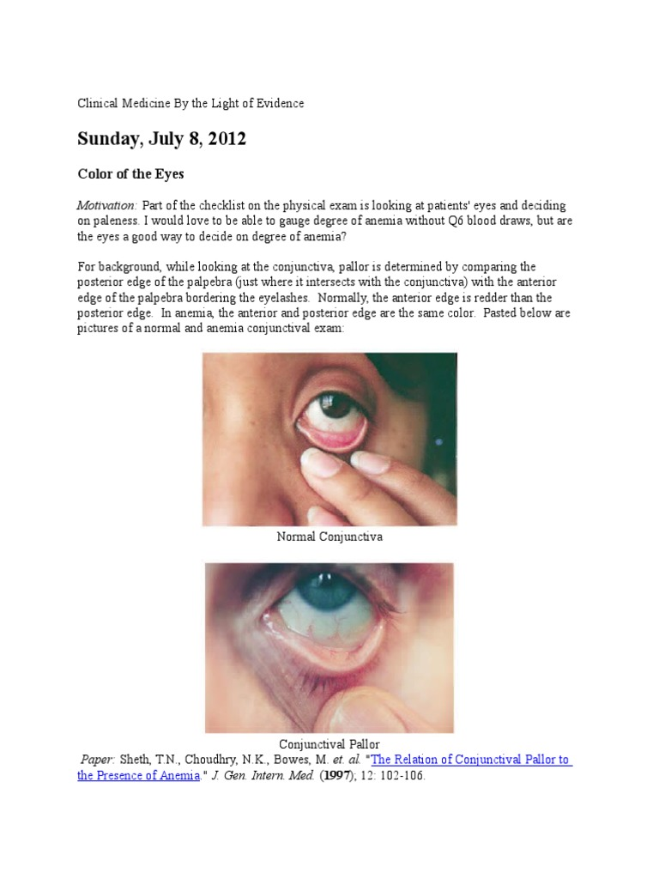
How to confirm true pallor?
CONJUNCTIVA: Classified as pale if the anterior rim of the lower palpebral conjunctiva appeared as pale as the deeper posterior rim.
Kalantri A and others. Accuracy and reliability of pallor for detecting anaemia: a hospital-based diagnostic accuracy study. PLoS One. 2010 Jan

Slide 14
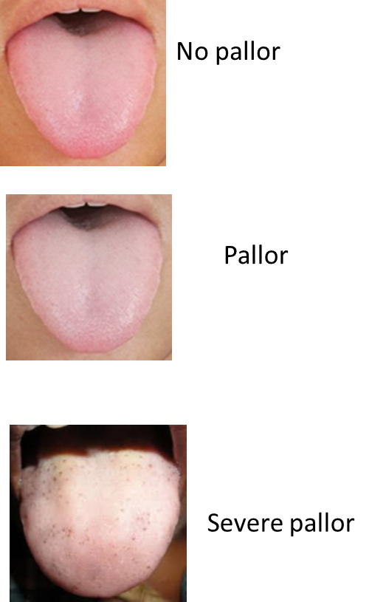
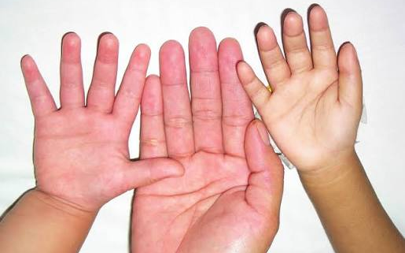
How to confirm true pallor?
Normal
TONGUE: Assessed by looking at the dorsum (top surface) of the tongue.
PALM: Evaluated by examining the intensity of the color of the palmar creases.
NAILBED: Assessed by observing the color of the fingernail.
Pale
pallor
Kalantri A and others. Accuracy and reliability of pallor for detecting anaemia: a hospital-based diagnostic accuracy study. PLoS One. 2010 Jan

Slide 15
How to confirm true pallor?
Some local conditions that may obscure (mask) the pallor:
  Conjunctiva: Conjunctival infection/inflammation
  Palm: Vasodilation caused by some other disorder
  Tongue: oral thrush
  In any of these conditions, #use_another_anatomical_site

Slide 16
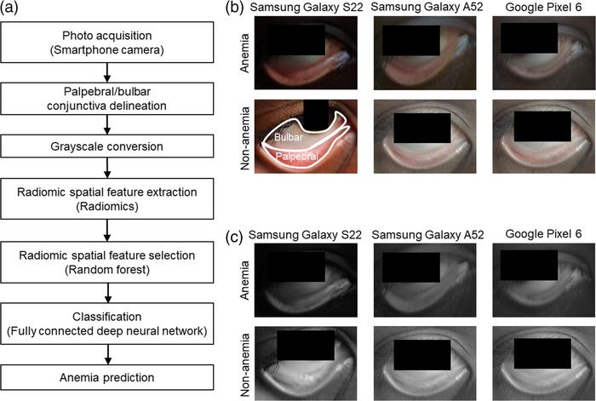
How to confirm true pallor?
New methods to detect pallor:
  Some applications can detect the pallor in the conjunctiva or palm by using the phone’s camera
  This technology can be used as screening method for anemia in school aged children
Noninvasive method detects anemia in children by analyzing smartphone photos of the eye’s conjunctiva
(15 Apr 2025) https://doi.org/10.1117/1.BIOS.2.2.022303

Slide 17
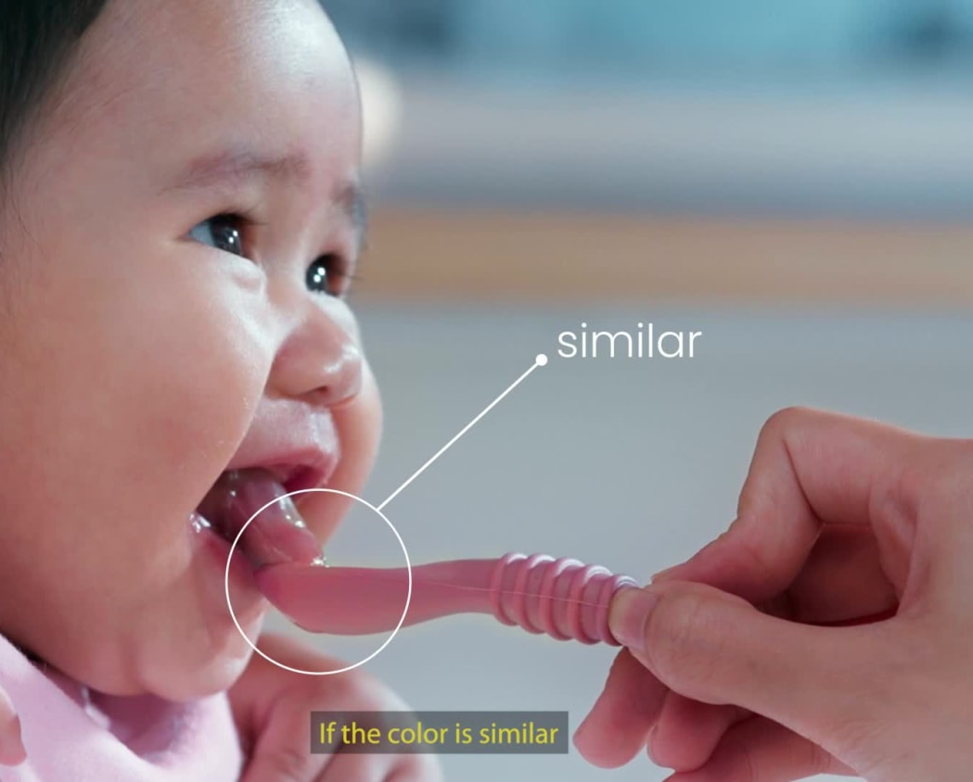
How to confirm true pallor?
New methods to detect pallor:
  Some products/tools can be used as a visual reference for the normal color of infant’s tongue, which helps mothers detect anemia in their babies.

Slide 18
PART 2
Differential Diagnosis of Pallor

Slide 19
Differential Diagnosis of Pallor
Pallor with anemia
Pallor without anemia

Slide 20
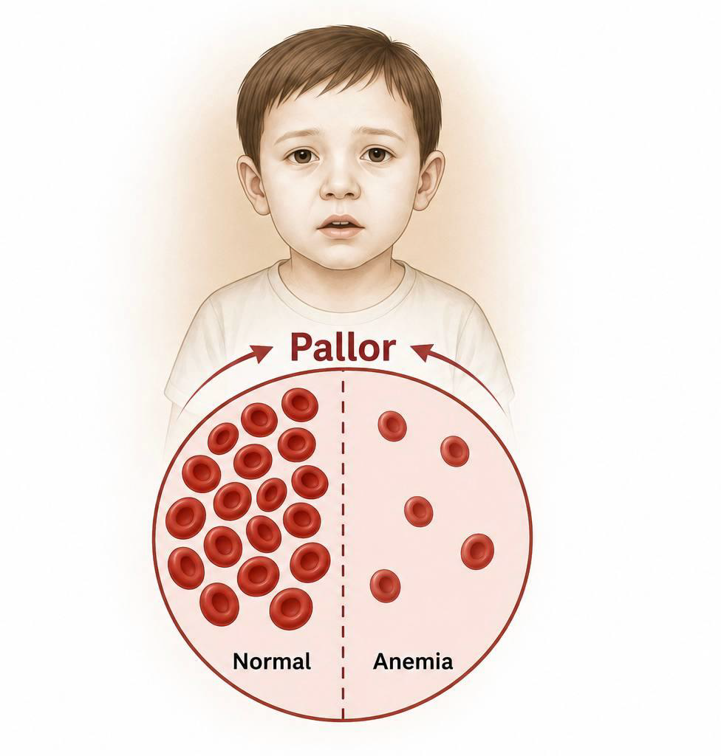
Pallor with anemia
1. Decreased red blood cell production
Occurs when the bone marrow cannot produce sufficient RBCs.

Slide 21
Pallor with anemia
1. Decreased red blood cell production
A. Nutritional Deficiency
B. Bone Marrow Failure
C. Bone Marrow Infiltration
D. Chronic Disease
E. Endocrine Disorders

Slide 22
Pallor with anemia
1. Decreased red blood cell production
A. Nutritional Deficiency
  Iron deficiency anemia (most common worldwide)
  Vitamin B12 deficiency
  Folate deficiency
B. Bone Marrow Failure
C. Bone Marrow Infiltration
D. Chronic Disease
E. Endocrine Disorders

Slide 23
Pallor with anemia
1. Decreased red blood cell production
A. Nutritional Deficiency
B. Bone Marrow Failure
  Aplastic anemia
  Fanconi anemia
  Diamond–Blackfan anemia
C. Bone Marrow Infiltration
D. Chronic Disease
E. Endocrine Disorders

Slide 24
Pallor with anemia
1. Decreased red blood cell production
A. Nutritional Deficiency
B. Bone Marrow Failure
C. Bone Marrow Infiltration
  Acute leukemia
  Lymphoma
  Neuroblastoma metastasis
D. Chronic Disease
E. Endocrine Disorders

Slide 25
Pallor with anemia
1. Decreased red blood cell production
A. Nutritional Deficiency
B. Bone Marrow Failure
C. Bone Marrow Infiltration
D. Chronic Disease
  Chronic kidney disease (↓ erythropoietin)
  Chronic inflammatory diseases
  Malignancy
E. Endocrine Disorders

Slide 26
Pallor with anemia
1. Decreased red blood cell production
A. Nutritional Deficiency
B. Bone Marrow Failure
C. Bone Marrow Infiltration
D. Chronic Disease
E. Endocrine Disorders
  Hypothyroidism
  Pituitary insufficiency (rare)

Slide 27
Pallor with anemia
2. Increased red blood cell destruction
A. Hereditary hemolytic disorders
B. Acquired hemolytic disorder
  Hereditary spherocytosis
  G6PD deficiency
  Pyruvate kinase deficiency
  Sickle cell disease
  Thalassemia
  Autoimmune hemolytic anemia
  Hemolytic uremic syndrome
  Disseminated intravascular coagulation
  Drug induced hemolysis
  Severe infection (e.g. malaria)

Slide 28
Pallor with anemia
3. Blood loss
A. Acute Blood Loss
B. Chronic Blood Loss
  Trauma
  Surgery
  Gastrointestinal bleeding
  Epistaxis
  Intracranial hemorrhage (neonates)
  Hookworm infestation
  Occult gastrointestinal bleeding
  Meckel diverticulum
  Inflammatory bowel disease
  Heavy menstrual bleeding in adolescents

Slide 29
Differential Diagnosis of Pallor
Pallor with anemia
Pallor without anemia

Slide 30
Pallor without anemia
Peripheral Vasoconstriction (The Most Common Cause)
    Cold exposure
    Hypovolemia
    Fear or emotional stress

Slide 31
Pallor without anemia
2. Cardiovascular Disorders
    Congestive heart failure
    Low cardiac output states
    Severe congenital heart disease

Slide 32
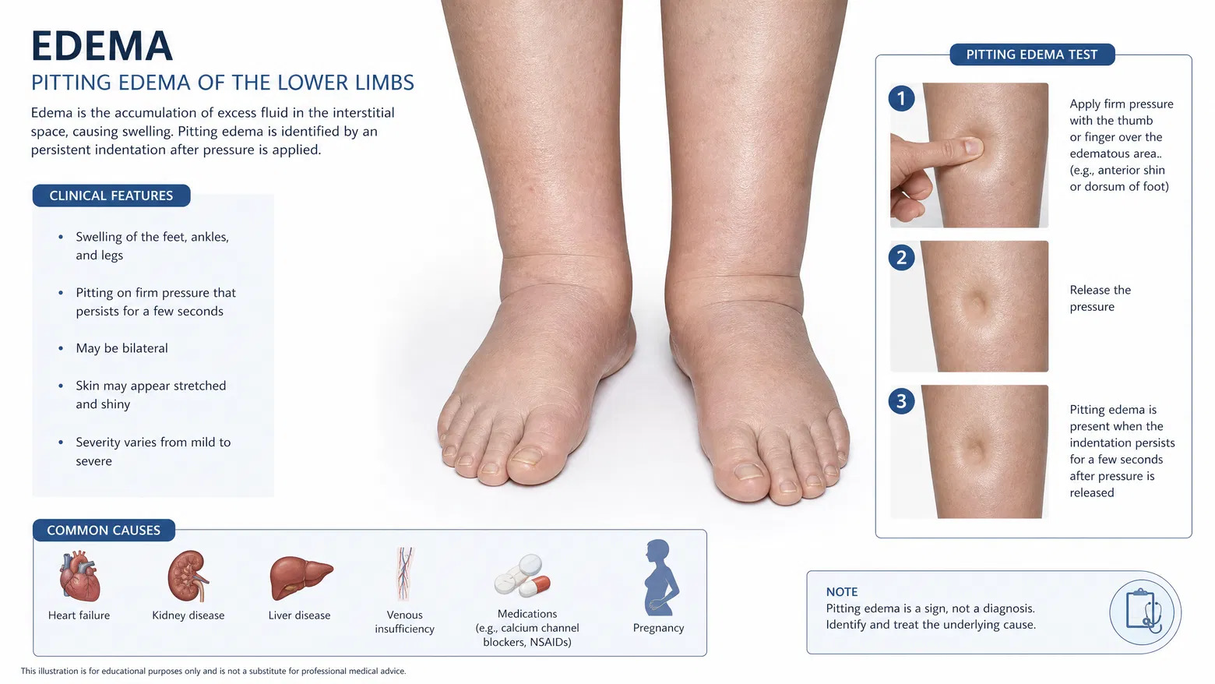
Pallor without anemia
3. Edematous States
    Nephrotic syndrome
    Congestive heart failure
    Vasculitis with generalized edema

Slide 33
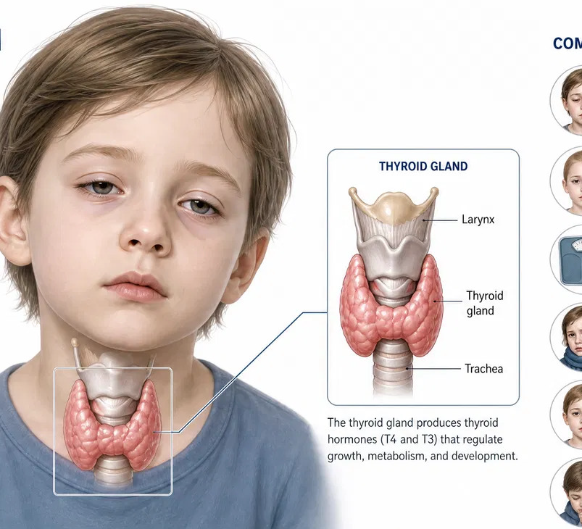
Pallor without anemia
4. Endocrine Disorders
    Hypothyroidism

Slide 34
Pallor without anemia
5. Constitutional (Physiological) Pallor
    Fair complexion
    Thin skin
    Familial pale appearance

Slide 35
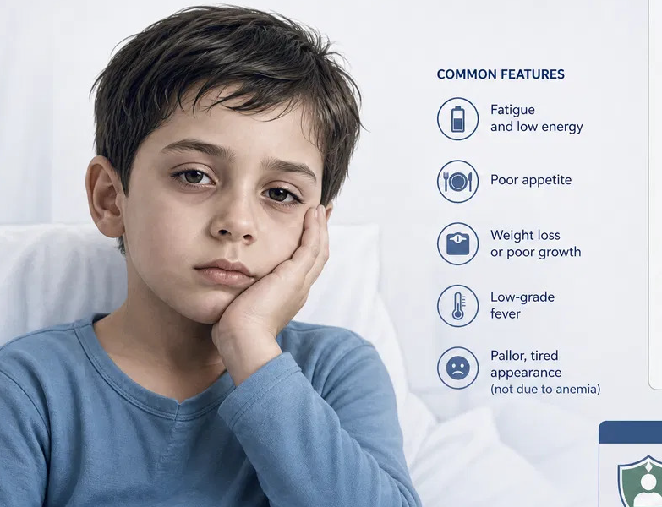
Pallor without anemia
6. Chronic Illness Without
Significant Anemia
    Chronic infections
    Post-inflammatory
    Chronic liver disease

Slide 36
Pallor without anemia
7. Disorders of Skin Pigmentation
    Albinism
    Vitiligo
    hypopigmentation

Slide 37
Pallor without anemia
8. Acute Shock
(pediatric Emergency)
    Septic shock
    Hypovolemic shock
    Cardiogenic shock

Slide 38
PART 3
Focused History Taking in a Child With Pallor

Slide 39
1. Demographic Data
Age & Sex Diagnostic Clues
  Neonates: Hemorrhage, Rh/ABO incompatibility, or severe congenital hemolytic anemias.
  6-24 Months: Peak incidence for Iron Deficiency Anemia (IDA) due to dietary transition.
  Older Children: Chronic disease, GI blood loss, acquired hemolysis, or malignancy.
  Males: X-linked recessive disorders (e.g., G6PD deficiency).
  Adolescent Females: Menorrhagia / Heavy menstrual bleeding.

Slide 40
2. Chief Complaint
"Paleness noticed by parents / caregiver"
  Key Question: "When was the pallor first noticed, and has it been constant or progressive?“
  Establishing accurate duration distinguishes acute emergencies from insidious chronic conditions.

Slide 41
3. History of Present Illness (HPI)
  A. Onset & Progression
    Sudden Onset: Suggests acute hemolysis (G6PD crisis, autoimmune AIHA) or acute hemorrhage.
    Gradual / Insidious Onset: Points toward nutritional deficiency, bone marrow failure, or chronic inflammation.
  B. Functional Severity Assessment
    General Symptoms: Fatigue, lethargy, irritability, poor feeding, or poor suckling in infants.
    Cardiorespiratory Compromise: Shortness of breath, dyspnea on exertion, dizziness, lightheadedness, syncope, or palpitations.

Slide 42
4. Etiology-Driven Framework Overview
Category 1
Decreased RBC Production
Nutritional Deficiencies (Iron, B12, Folate)
Bone Marrow Failure (Aplastic)
Bone Marrow Infiltration (Leukemia)
Chronic Diseases (CKD, IBD)

Slide 43
4. Etiology-Driven Framework Overview
Category 2
Increased RBC Destruction
Hereditary Hemolytic (G6PD, Sickle Cell, Thalassemia)
Acquired Hemolytic (AIHA, HUS)
Infections (Malaria, Sepsis)

Slide 44
4. Etiology-Driven Framework Overview
Category 3
Blood Loss
Acute Blood Loss (Trauma, Birth)
Chronic GI Loss (Melena, Parasites)
Adolescent Menorrhagia

Slide 45
Category 1: Nutritional Deficiencies
Iron Deficiency Anemia (IDA)
"Is the child consuming excessive cow's milk (> 500 mL/day or introduced before 1 year)?“
"Is the child exclusively breastfed past 6 months without iron supplementation/fortified foods?“
"Does the child exhibit Pica (craving non-food items like dirt, ice, paper, or clay)?“

Slide 46
Category 1: Nutritional Deficiencies
Vitamin B12 & Folate Deficiency
"Does the child/mother follow a strict vegan diet without supplementation?“
"Is there a history of chronic diarrhea, malabsorption, or intestinal surgery?"

Slide 47
Category 1: Bone Marrow Disorders
Bone Marrow Failure
Thrombocytopenia: "Are there skin changes like petechiae, purpura, easy bruising, or gum/nose bleeding?“
Neutropenia: "Is there a history of recurrent or severe infections/fevers?“
Congenital Anomalies: "Were there skeletal defects noted at birth (e.g., thumb or hand anomalies)?"

Slide 48
Category 1: Bone Marrow Disorders
Bone Marrow Infiltration
Leukemia, Lymphoma, Neuroblastoma
Bone Pain: "Does the child complain of persistent bone/joint pain that wakes them at night?“
Lymphadenopathy: "Have you noticed painless lumps or swollen lymph nodes in the neck, armpits, or groin?“
Constitutional Signs: Unexplained prolonged fever, night sweats, or weight loss.

Slide 49
Category 1: Chronic Diseases
Renal Pathology (CKD):
"Is there a known history of kidney disease, facial swelling, or changes in urine output?“
Chronic Inflammation (IBD/Rheumatic):
"Are there signs of chronic inflammation like persistent abdominal pain, chronic diarrhea, or joint swelling?“
Endocrine Disorders (Hypothyroidism):
"Are there hypothyroid symptoms: severe constipation, dry skin, coarse hair, or growth delay?"

Slide 50
Category 2: Hereditary Hemolytic Anemias
G6PD Deficiency
"Did the child recently ingest fava beans?"
"Was there exposure to oxidative drugs (sulfonamides) or mothballs?"
"Did you notice dark red, brownish, or tea-colored urine?“
Sickle Cell Disease
"Does the child suffer from severe acute painful episodes in bones or abdomen?"
"Has there been dactylitis (painful swollen hands/feet)?“
Thalassemia & Spherocytosis
"Has the child experienced yellowish discoloration of eyes/skin (Jaundice)?"
"Is there a family history of early gallstones or early splenectomy?"

Slide 51
Category 2: Acquired Hemolytic Disorders
Immune & Microangiopathic Hemolysis
HUS Clue: "Was there a recent viral/bacterial infection or an episode of bloody diarrhea?"
Drug-Induced (AIHA): "Has the child started any new medications recently?“
Infectious & Endemic Exposure
Malaria Risk: "Has the child traveled to or lived in a malaria-endemic region?"
Systemic Infection: Signs of sepsis, prolonged fever, or hemodynamic instability.

Slide 52
Category 3: Blood Loss Assessment
Acute Blood Loss
"Is there a history of recent trauma, surgical procedures, or acute visible bleeding?"
Neonates: "Was there birth trauma, fetal-maternal hemorrhage, or umbilical cord bleeding?“
Chronic Blood Loss
Gastrointestinal: "Is stool black/tarry (Melena) or containing bright red blood (Hematochezia)?"
Parasitic: "Does the child walk barefoot on dirt/soil?" (Risk of Hookworm infestation)
Adolescents: "Are menses unusually heavy (>7 days) or containing large clots?"

Slide 53
Past Medical History
Perinatal: Prematurity, low birth weight (depleted iron stores), neonatal jaundice/phototherapy.
Prior Episodes: Recurrent anemia, transfusions.

Slide 54
Drug & Exposure
Meds: NSAIDs/steroids (GI bleeding), oxidative drugs (G6PD hemolysis).
Environment: Lead paint pica or heavy metal exposure.

Slide 55
Family History
Genetics: Thalassemia, Sickle Cell, G6PD, Spherocytosis.
Consanguinity: Parental relation (autosomal recessive conditions).

Slide 56
PART 4
Physical Examination

Slide 57
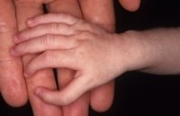
General Look & Appearance
Overall Status: Alertness / Lethargy
Respiratory Distress: Effort / Recessions
Dysmorphic Features: Congenital facies (Fanconi / Diamond-Blackfan)

Slide 58
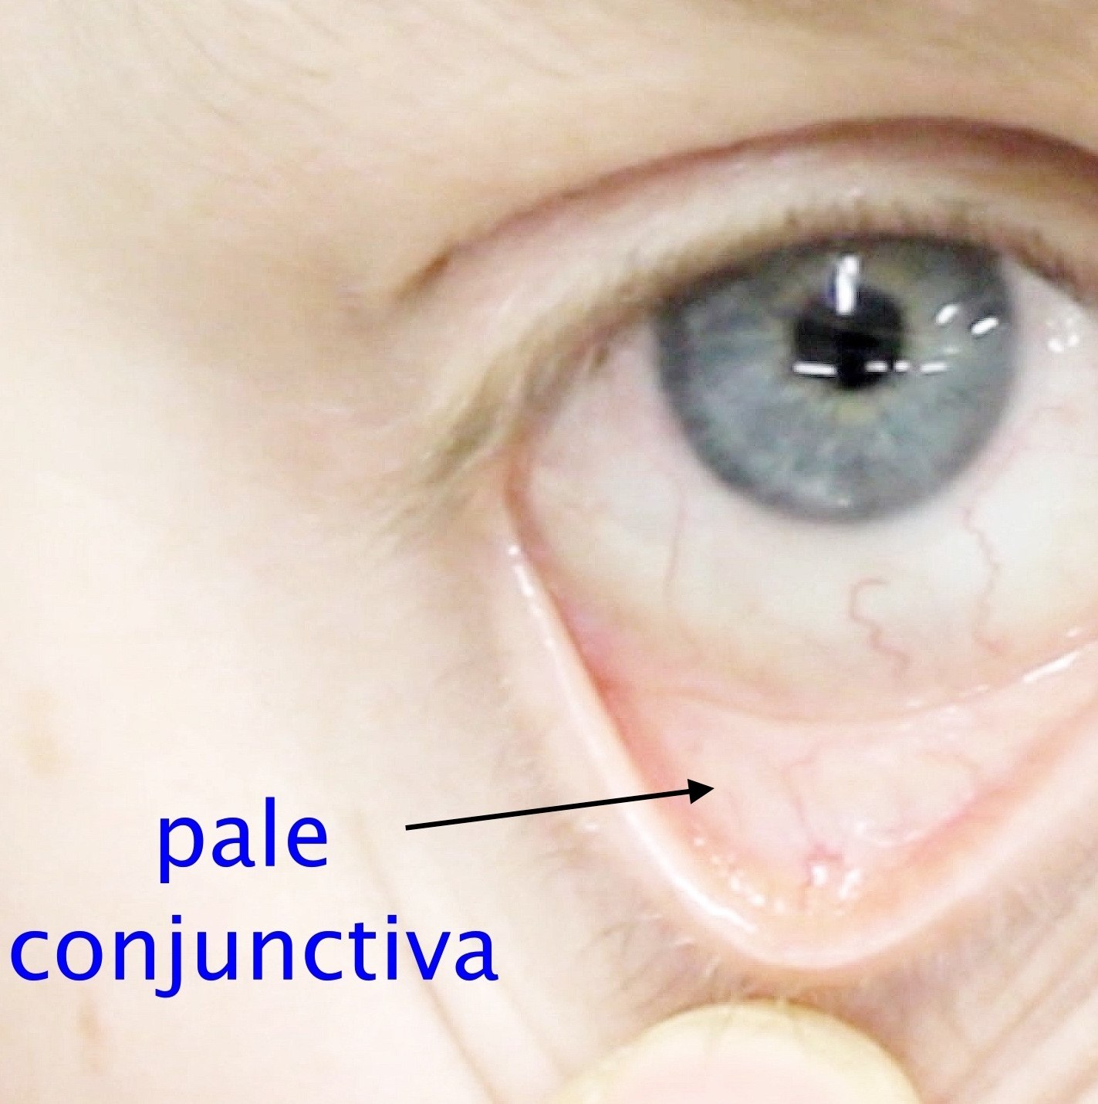
Head & HEENT
Eyes & Conjunctivae: Conjunctival pallor / Scleral icterus / Retinal hemorrhages
Ears & Nose: Epistaxis / Mucosal pallor
Oral Cavity: Atrophic glossitis / Angular cheilitis / Bleeding gums
Skull & Facies: Frontal bossing / Chipmunk facies (Thalassemia)

Slide 59
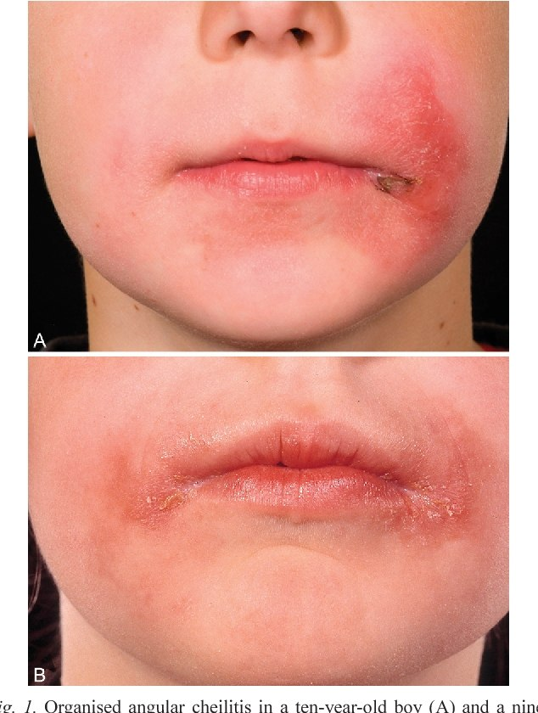
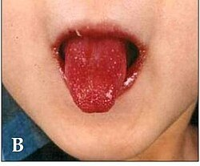
Head & HEENT
Eyes & Conjunctivae: Conjunctival pallor / Scleral icterus / Retinal hemorrhages
Ears & Nose: Epistaxis / Mucosal pallor
Oral Cavity: Atrophic glossitis / Angular cheilitis / Bleeding gums
Skull & Facies: Frontal bossing / Chipmunk facies (Thalassemia)

Slide 60
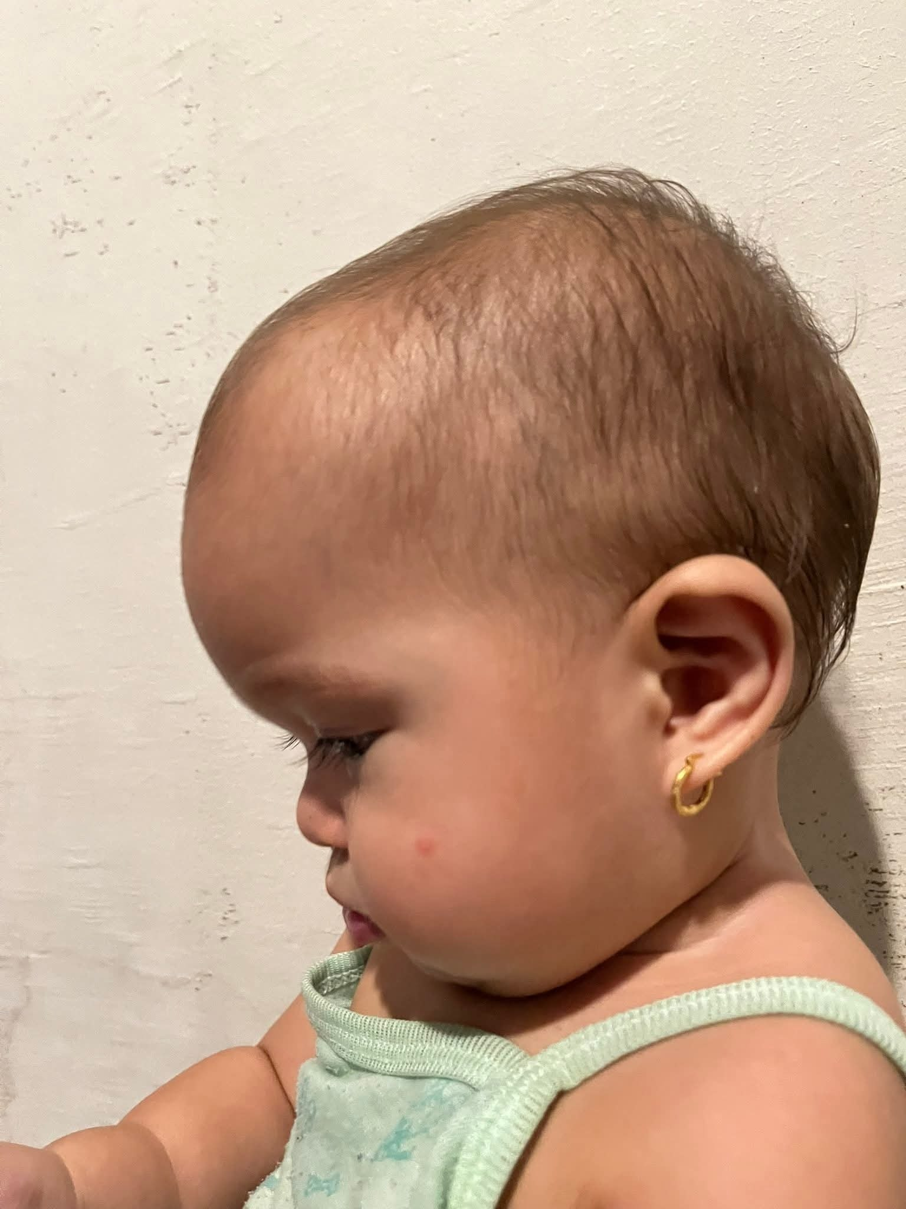
Head & HEENT
Eyes & Conjunctivae: Conjunctival pallor / Scleral icterus / Retinal hemorrhages
Ears & Nose: Epistaxis / Mucosal pallor
Oral Cavity: Atrophic glossitis / Angular cheilitis / Bleeding gums
Skull & Facies: Frontal bossing / Chipmunk facies (Thalassemia)

Slide 61
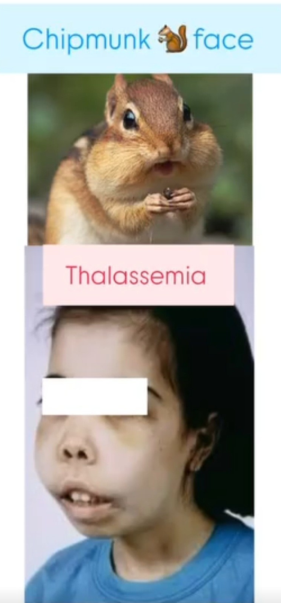
Head & HEENT
Eyes & Conjunctivae: Conjunctival pallor / Scleral icterus / Retinal hemorrhages
Ears & Nose: Epistaxis / Mucosal pallor
Oral Cavity: Atrophic glossitis / Angular cheilitis / Bleeding gums
Skull & Facies: Frontal bossing / Chipmunk facies (Thalassemia)

Slide 62
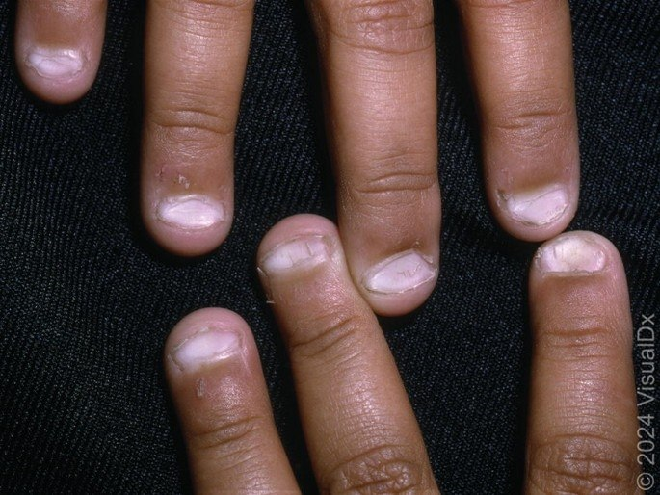
Skin & Appendages
Pallor & Jaundice: Palms / Soles / Creases
Bleeding: Petechiae / Purpura / Ecchymoses
Nails & Hair: Koilonychia (Spoon nails) / Capillary refill / Brittle hair

Slide 63
Vital Signs
Pulse Rate & Rhythm: Tachycardia (Compensatory / Shock)
Respiratory Rate: Tachypnea (Hypoxia / Acidosis)
Blood Pressure: Hypotension (Late shock) / Wide pulse pressure (Hyperdynamic)
Temperature: Fever (Infection / Hemolysis / Malignancy)
Oxygen Saturation: SpO2 (Oxygenation / Cardiopulmonary)

Slide 64
Growth Parameters
Plotting: Height / Weight / Head circumference
Clinical Significance: Failure to thrive / Growth stunting (Chronic disease / Malabsorption / Malnutrition)

Slide 65
Systemic examination
Cardiovascular system
Abdomen
Auscultation: Systolic murmur (Flow murmur) / Hyperdynamic precordium
Heart Failure: Gallop rhythm / Cardiomegaly
Splenomegaly: Hemolysis / Portal hypertension / Storage diseases / Malignancy.
Hepatomegaly: Extramedullary hematopoiesis / Heart failure / Infiltration

Slide 66
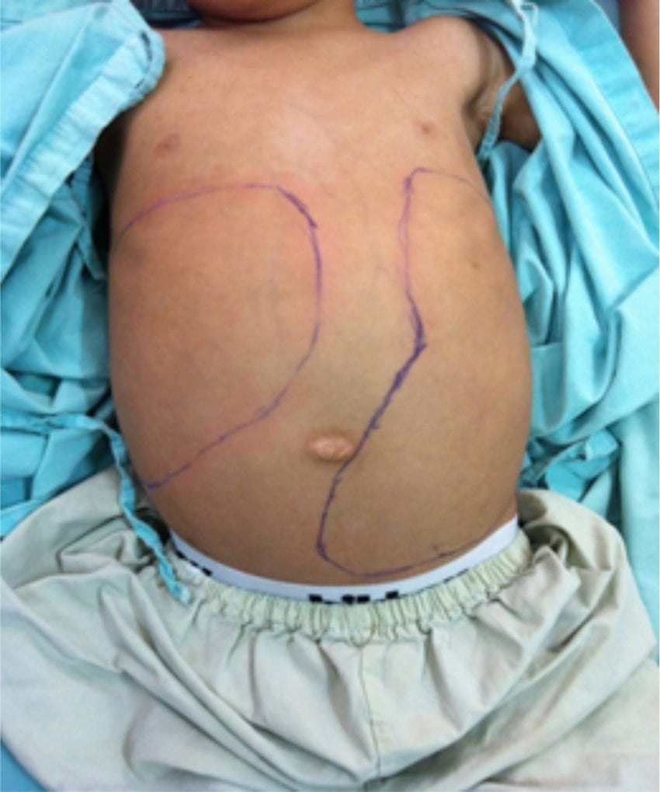
Systemic examination
Abdomen
Splenomegaly: Hemolysis / Portal hypertension / Storage diseases / Malignancy.
Hepatomegaly: Extramedullary hematopoiesis / Heart failure / Infiltration

Slide 67
Systemic examination
Musculoskeletal System
Lymphatic System
Bony Tenderness: Marrow expansion / Leukemia
Joints & Extremities: Arthritis (JIA) / Deformities (Absent radii) / Dactylitis (Sickle cell)
Lymphadenopathy: Infection / Lymphoma / Leukemia

Slide 68
PART 5
Initial Diagnostic Approach and First-line Investigations

Slide 69

General Investigations
Complete Blood Count (CBC)
Peripheral Blood Film (PBF) and Reticulocyte Count
Hemolytic Markers
Renal Function Tests (RFT)

Slide 70
General Investigations
Complete Blood Count (CBC)
Hb HCT MCHC WBC
│ │ │ │
▼ ▼ ▼ ▼
Confirms Severity ↑ Hereditary Aplastic anemia
anemia of anemia spherocytosis & Leukemia

Slide 71
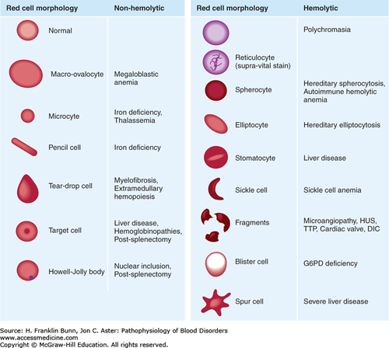
Peripheral Blood Film (PBF) & Reticulocyte Count
Peripheral Blood Film (PBF)
  Evaluates RBC morphology and size.
  Normal RBC size ≈ nucleus of a mature lymphocyte.
  Central pallor ≈ one-third of RBC diameter.
Increased Reticulocyte Count (Reticulocytosis)
  Indicates an active bone marrow response.
  Commonly seen in:
    Hemolytic anemia
    Acute blood loss (hemorrhage)

Slide 72
Peripheral Blood Film (PBF) & Reticulocyte Count
Decreased Reticulocyte Count (Reticulocytopenia)
Suggests reduced bone marrow production of RBCs.
Seen in:
Aplastic crisis
Bone marrow failure

Slide 73
PART 6
Classification of Anemia Based on MCV and Reticulocyte Count
What is MCV?
Mean Corpuscular Volume (MCV)is the average volume (size) of red blood cells (RBCs), measured in femtoliters (fL).
Normal Values:Children: 80–95 fL | Newborns: 96–108 fL

Slide 74
PART 6
Classification of Anemia Based on MCV and Reticulocyte Count
What is MCV?
Mean Corpuscular Volume (MCV)is the average volume (size) of red blood cells (RBCs), measured in femtoliters (fL).
Normal Values:Children: 80–95 fL | Newborns: 96–108 fL

Slide 75
Microcytic anemia
(MCV < 80 fL)
Iron deficiency anemia (most common)
Thalassemia | Anemia of chronic disease
Lead poisoning | Sideroblastic anemia (rare)

Slide 76
2. Normocytic anemia
(MCV 80–95 fL)
Acute blood loss | Hemolytic anemia
Anemia of chronic disease | Early iron deficiency
Aplastic anemia

Slide 77
3. Macrocytic anemia
(MCV > 95 fL)
1. Megaloblastic
Vitamin B12 deficiency
Folate deficiency
2. Non-megaloblastic
Hypothyroidism
Liver disease
Bone marrow disorders
Reticulocytosis

Slide 78
Pure red cell aplasia:
Diamond Blackfan Anemia (DBA)
Congenital pure red cell aplasia
Presents in early infancy
Associated with macrocytosis & congenital anomalies (e.g., triphalangeal thumb)
Transient Erythroblastopenia of Childhood (TEC)
Acquired pure red cell aplasia
Usually occurs in toddlers
Typically normocytic or mildly macrocytic
Usually resolves spontaneously

Slide 79
Reticulocyte Count-Based anemia classification
What is a Reticulocyte?
Reticulocytes are immature red blood cells (RBCs) recently released from the bone marrow into peripheral circulation.
Normal Reference Values
Children:0.5 –2.0% Newborns:2.0 –6.0%
Clinical Significance
The reticulocyte count directly reflects bone marrow erythropoietic activity and distinguishes production failure from RBC destruction or loss.

Slide 81
Hyporegenerative vs Regenerative
Hyporegenerative Anemia
Indicates inadequate bone marrow response due to decreased RBC production
  Iron deficiency anemia
  Vitamin B12 or folate deficiency
  Aplastic anemia / bone marrow failure
  Anemia of chronic disease
  Chronic kidney disease
Regenerative Anemia
Indicates an appropriate bone marrow response due to increased RBC loss or destruction
  Hemolytic anemia
  Acute blood loss
  Recovery after treatment of nutritional anemia

Slide 82
PART 7
Etiology-Specific Investigations
Once first-line tests (CBC, indices, reticulocyte count, and peripheral smear) suggest a specific category of anemia, targeted investigations are ordered to confirm the exact etiology. These include:
Iron studies
Hemolysis workup
Hemoglobin electrophoresis
Bone marrow examination
Renal investigations

Slide 83
PART 7
Etiology-Specific Investigations
Once first-line tests (CBC, indices, reticulocyte count, and peripheral smear) suggest a specific category of anemia, targeted investigations are ordered to confirm the exact etiology. These include:
Iron studies
Hemolysis workup
Hemoglobin electrophoresis
Bone marrow examination
Renal investigations

Slide 84
Iron studies
Indication:
Ordered in microcytic, hypochromic anemia with low RPI. Helps differentiate Iron Deficiency Anemia (IDA) from Anemia of Chronic Disease (ACD) and thalassemia trait.
Typical findings in IDA:
↓ Serum ferritin: Reflects decreased iron stores.
↓ Serum iron: Indicates reduced circulating iron.
↑ TIBC: Increased iron-binding capacity.
↓ Transferrin saturation: Reduced iron available for hemoglobin synthesis.
Note: Ferritin may be falsely elevated in inflammation (acute-phase reactant).

Slide 85
Hemolysis
Workup
1. General screening for hemolysis
↑ Serum LDH: Due to RBC destruction.
↑ Indirect bilirubin: Due to hemoglobin
breakdown.
↓ Haptoglobin: Due to binding with free
hemoglobin.
2. Tests to identify the cause of hemolysis
Direct Coombs test: Detects RBC antibodies/complement → Immune hemolytic anemia.
Red cell enzyme assay: Detects enzyme deficiencies (e.g., G6PD, pyruvate kinase).
Hereditary spherocytosis screening: EMA binding or osmotic fragility test detects RBC membrane defects.
Indication:
Ordered in normocytic or macrocytic anemia with high reticulocyte count, or when hemolysis is suspected (jaundice, dark urine, splenomegaly).

Slide 86
Hemoglobin
Electrophoresis
Typical findings:
β-Thalassemia Trait: ↑ HbA₂ (>3.5%), ± slight ↑HbF.
β-Thalassemia Major: ↓ or absent HbA, HbF
predominates (>90%).
Sickle Cell Disease (HbSS): Predominantly HbS (80–90%), ↑ HbF, absent HbA.
Normal (after 1 year):
HbA: >95%
HbA₂: 1.5–3.5%
HbF: <1–2%
NOTE:
α-thalassemia trait is not reliably diagnosed by
electrophoresis; genetic testing is required.
Indication:
Ordered when hemoglobinopathy is suspected (e.g., SCD or thalassemia) based on family history, ethnicity, microcytic anemia unresponsive to iron, or positive newborn screening.

Slide 87
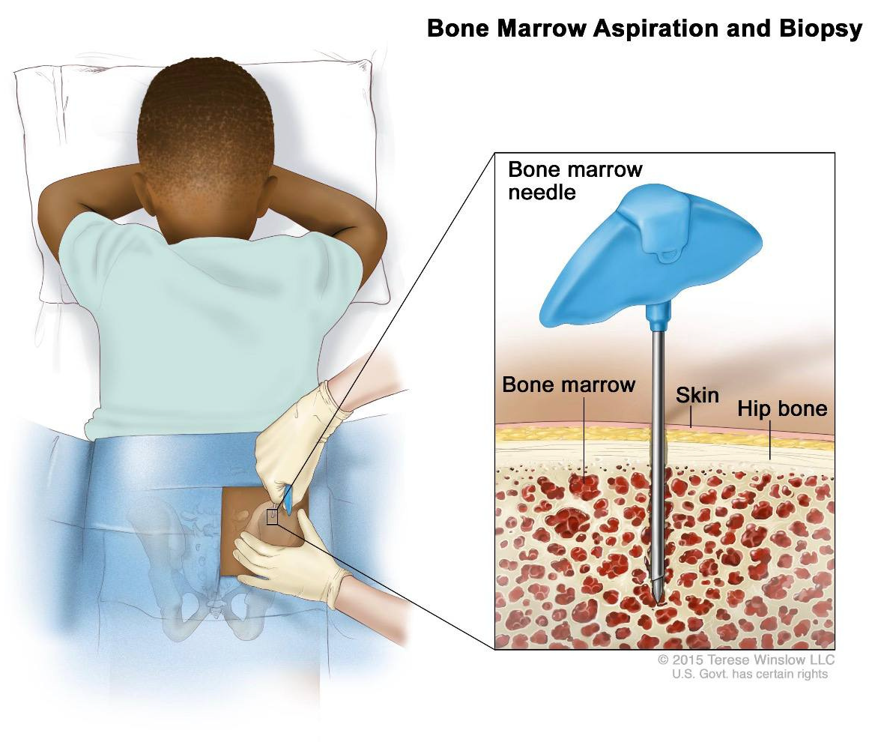
Bone Marrow
Examination
Indication:
An invasive procedure reserved for red flags in children with anemia.
Pancytopenia / bicytopenia: Anemia with low WBCs and/or platelets → suspect aplastic anemia or leukemia.
Abnormal peripheral smear: Unexplained blasts or atypical cells.
Refractory anemia: No response to appropriate therapy.
Suspected marrow infiltration or storage disease (e.g., Gaucher disease).

Slide 88
What it evaluates:
Cellularity.
Erythroid and myeloid maturation.
Megakaryocytes.
Abnormal infiltrates (e.g., blasts).
Findings:
↑ Erythroid precursors: Increased RBC production response (seen in some hemolytic anemias).
↓ Erythroid activity: Reduced RBC production (e.g., aplastic anemia, marrow suppression).
Abnormal cells or infiltration: Suggests leukemia or malignancy.

Slide 89
Renal
Investigations
Indication:
Considered in normocytic, normochromic anemia with low reticulocyte count, hypertension, edema, altered urine output, or suspected kidney disease.
Main investigations
1. Serum Creatinine & Blood Urea Nitrogen
2. Estimated GFR (eGFR)
3. Urinalysis
4. Erythropoietin (EPO) level
(when indicated)
Assess renal function.
↑ Creatinine / ↑ BUN → Impaired kidney function.
Measures kidney filtration capacity.
↓ eGFR → Reduced renal function.
Proteinuria → Renal disease.
Hematuria → Possible renal pathology.
Produced by kidneys and
stimulates RBC production.
CKD: ↓ EPO → ↓ RBC
production → anemia.

Slide 90
PART 8
Management of the child with pallor

Slide 91
Core Principles of Clinical Management
Maintain Cardiorespiratory Stability
Prioritize airway, breathing, and circulation (ABC).
Ensure adequate tissue oxygenation and stabilize hemodynamics immediately in acute or severe distress.
Treat Infections Promptly
Identify and manage co-existing bacterial, viral, or parasitic infections (e.g., malaria, sepsis) early.
Prevents ongoing bone marrow suppression and further clinical deterioration.

Slide 92
Avoid Unnecessary Transfusions
Adhere to restrictive transfusion protocols.
Reserve red blood cell administration strictly for severe anemia accompanied by hemodynamic compromise or clinical shock.
Baseline Hematology Before Empiric Therapy
Collect essential blood samples (FBC, reticulocyte count, peripheral blood film) prior to starting empiric iron or vitamin supplementation.
Prevents masking the underlying diagnosis and ensures appropriate targeted treatment.

Slide 93
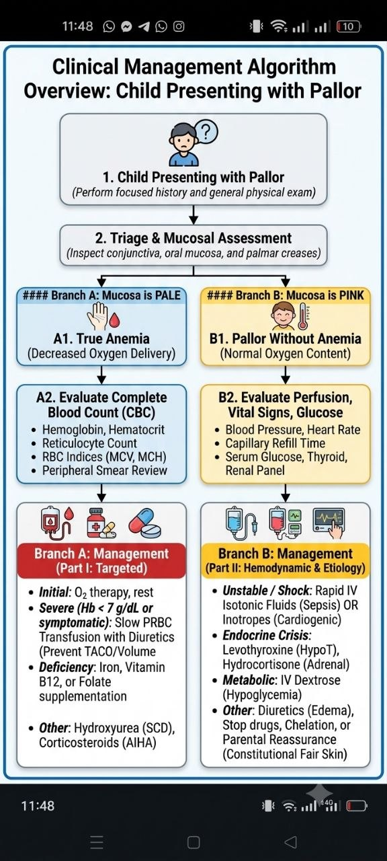

Slide 96
Etiology-Specific Management
1. Endocrine Disorders:
  ​Hypothyroidism:
    Initiate Levothyroxine replacement.
  ​Adrenal Crisis (Stable post-resuscitation):
    Stress-dose IV Hydrocortisone (50-100mg/m²) + hydration.
  ​Pheochromocytoma:
    Pre-operative alpha-blockers (e.g., Phenoxybenzamine).

Slide 97
Etiology-Specific Management
​2. Subcutaneous Edema (Masking Skin Perfusion):
  ​Nephrotic Syndrome:
    High-dose oral Prednisolone \pm diuretics for symptomatic fluid overload.
3. Autonomic / Transient Responses:
  ​Vasovagal Syncope:
    Supine positioning, leg elevation, oral fluids, and trigger avoidance (e.g., pain, fright).

Slide 98
Etiology-Specific Management
​​4. Toxins / Medication Exposure:
  ​Vasoconstrictors:
    Discontinue offending agents (e.g., OTC nasal decongestants like phenylephrine).
  ​Lead Toxicity:
    Chelation therapy (Succimer/DMSA) for confirmed severe toxicity.
​5. Constitutional / Fair Complexion (Normal Variant):
  ​Parental Reassurance:
    Reassure parents using normal FBC and bright pink oral mucosa to prevent unnecessary iron therapy or repeated blood testing

Slide 99
PART 9
Summary and Discussion

Slide 100
Common Clinical Pitfalls in Pediatric Pallor
Treat the patient, not only laboratory results.
Avoid empirical iron before confirming microcytic indices
(risk in thalassemia trait).
Reticulocyte count reflects bone marrow activity.
Always assess clinical red flags first.

Slide 101
Critical Red Flags in Pediatric Pallor
Hemodynamic instability.
Petechiae/purpura, fever, recurrent infections.
Hepatosplenomegaly or lymphadenopathy.
Active bleeding.
Jaundice and dark urine.

Slide 102
Clinical case
A 2-year-old child was brought to you in the clinic by his mother , she told you she noticed that he looks pale for 2 months and less active than before, Easy fatigability and decreased activity and Poor dietary intake with high milk consumption and,
by Examination Pale conjunctiva and Mild tachycardia.
Discussion:
What does this finding suggest?
What are the possible causes?
What investigations are needed?

Slide 103
Clinical case Discussion
2-year-old boy with pallor and high milk intake.
Likely IDA.
Differential: IDA, thalassemia trait, ACD, sideroblastic anemia, lead poisoning.
Investigations: CBC, smear, iron profile, retics, Mentzer index.
Management: Limit milk, oral iron 3–6 mg/kg/day, CBC after 4 weeks.

Slide 104
References
Key Take-Home Messages
Pallor is a sign; anemia is a lab diagnosis.
Rule out red flags before interpreting labs.
Dietary history is often the key.

Slide 105
References
Kliegman, R. M., et al. Nelson Textbook of Pediatrics E-Book. Elsevier Health Sciences, 2015.
Kalantri A and others. Accuracy and reliability of pallor for detecting anaemia: a hospital-based diagnostic accuracy study. PLoS One. 2010 Jan
Noninvasive method detects anemia in children by analyzing smartphone photos of the eye’s conjunctiva (15 Apr 2025) https://doi.org/10.1117/1.BIOS.2.2.022303
Pallor is a sign; anemia is a lab diagnosis.
Rule out red flags before interpreting labs.
Dietary history is often the key.

Slide 106
THANK YOU

